Slide 1
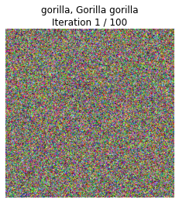
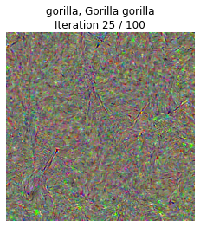
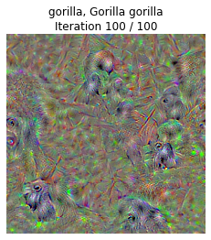
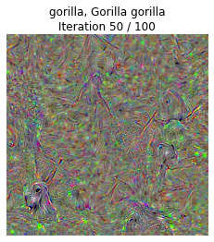
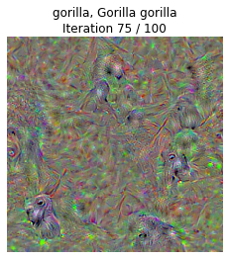
Class Model Visualization

Slide 2
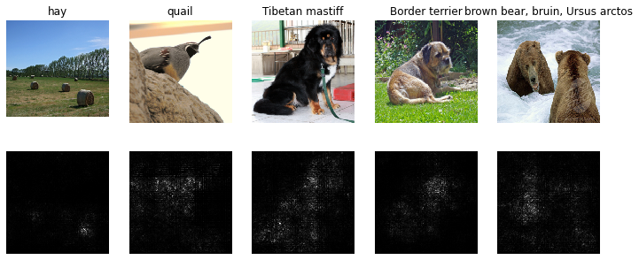
Saliency Map
Include your image-specific saliency map here

Slide 3
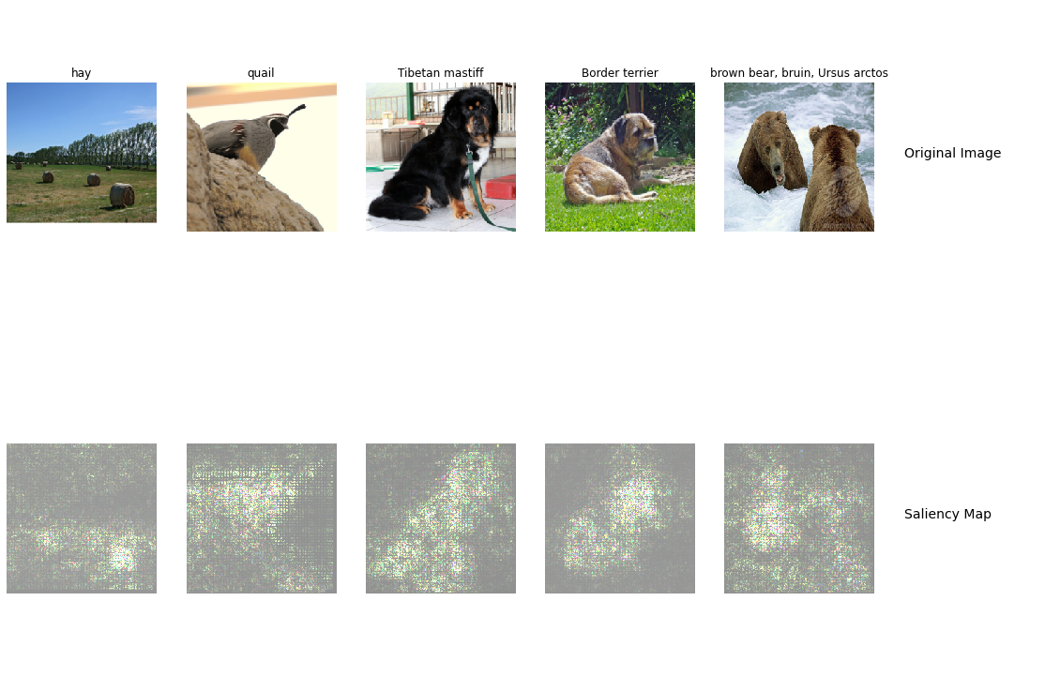
Saliency Map
Include your saliency map from Captum here

Slide 4
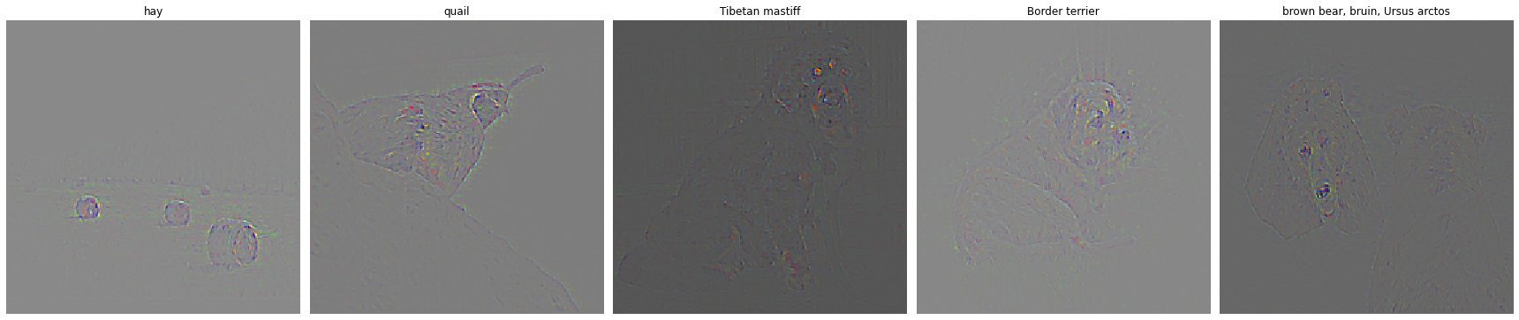
GradCam
Include your visualization of Guided Backprop here

Slide 5
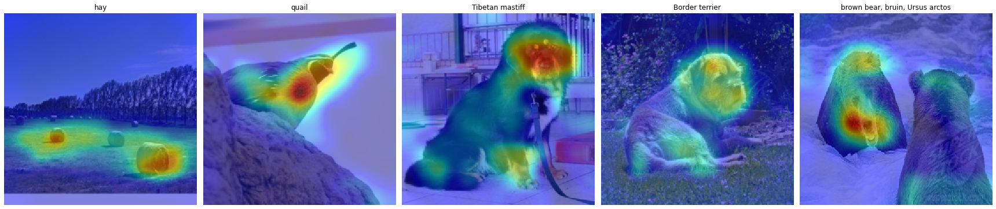
GradCam
Include your visualization of GradCam here

Slide 6
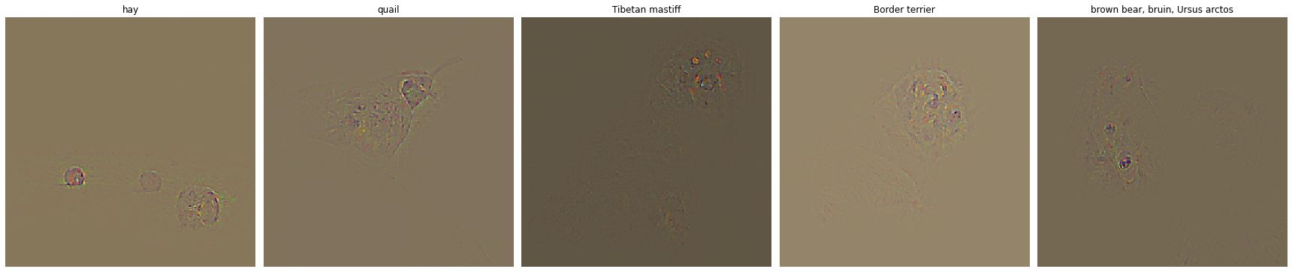
GradCam
Include your visualization of Guided GradCam here

Slide 7
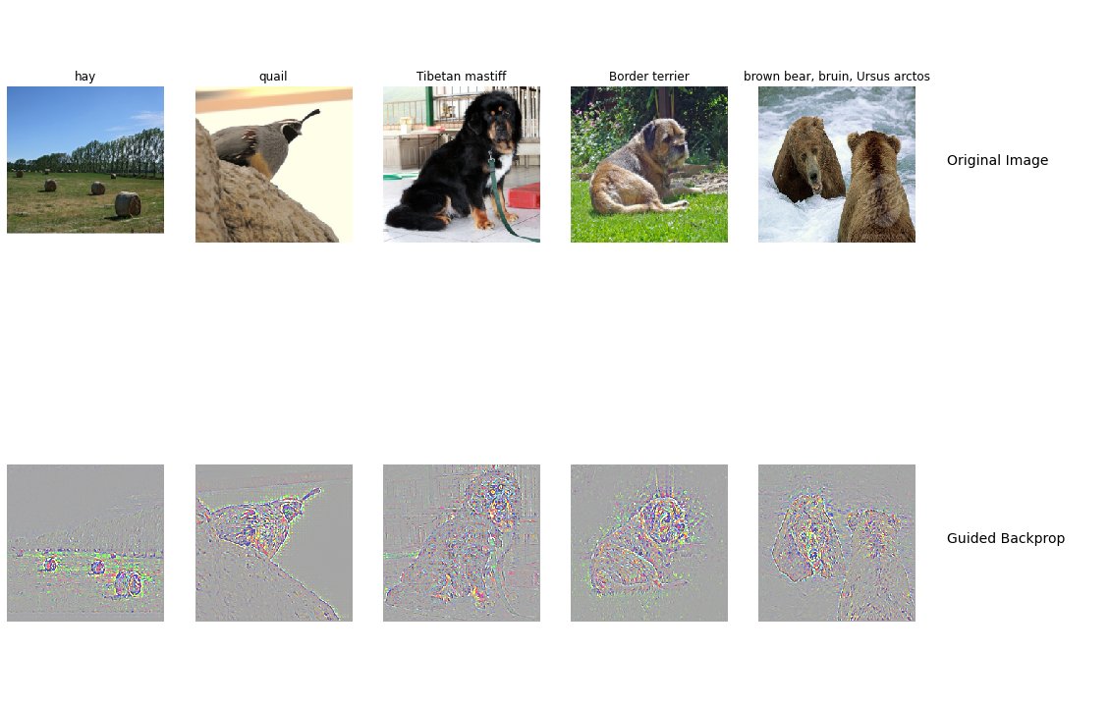
Guided Backprop - captum
Include your visualization of Guided Backprop and Guided Gradcam from Captum here

Slide 8

Guided GradCam - captum

Slide 9
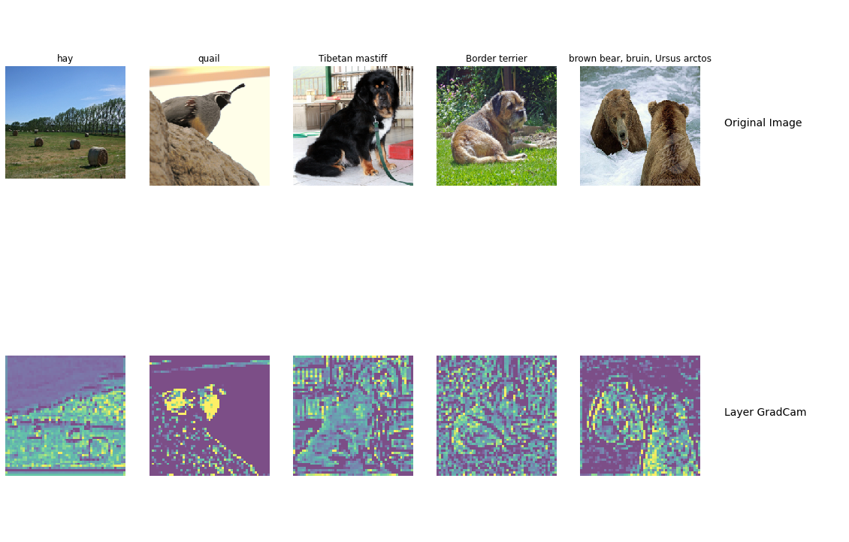
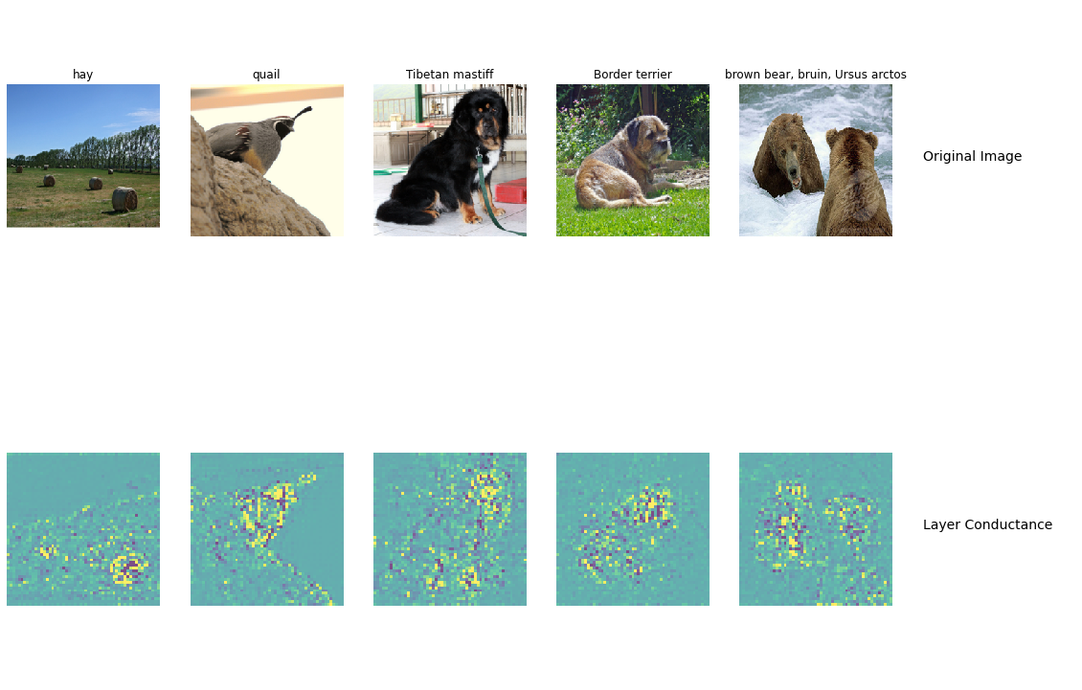
Layer GradCam and conductance - captum

Slide 10
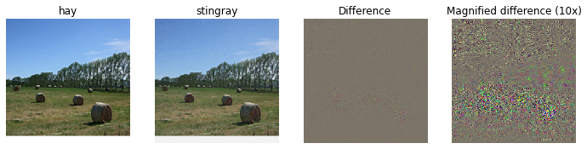
Fooling Image
Include the fooling image here

Slide 11
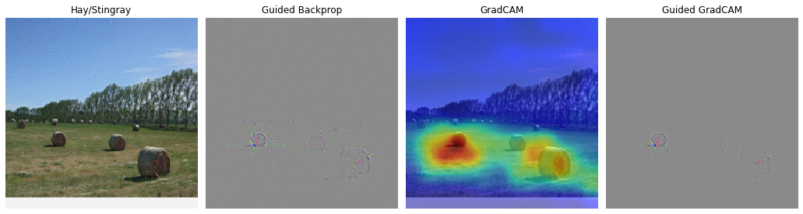
Fooling Image
Include the fooling image with image-specific visualizations here

Slide 12
Fooling Image
What insights do you get from fooling images:
Answer:
Very minor changes in the input pixel can alter the class prediction completely. However, all gradient-based visualization (e.g., gradcam) remain unchanged – the original true class are still highlighted, even when the predicted class completely changed.
Network is not stable. We need to include those adversarial examples in the training to generate more robust model.
Some adversarial examples are rare, but are dense, and are important to be used to improve the network generalization.

Slide 13
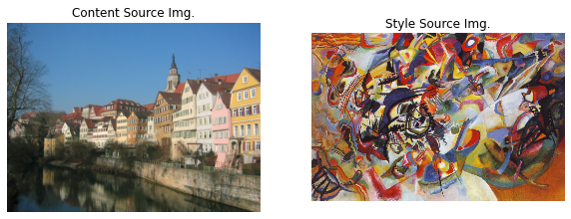
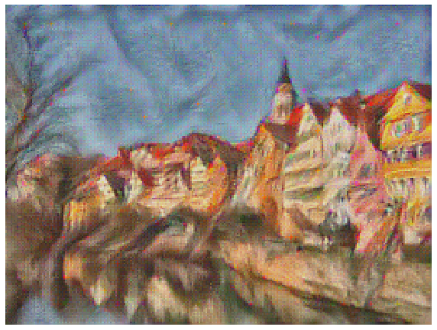
Composition VII + Tubingen
Include both original images and the transferred image

Slide 14
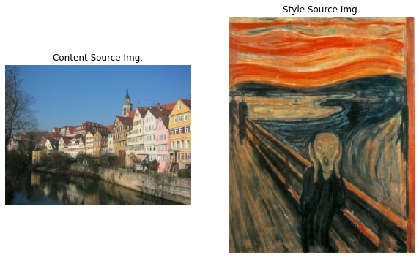
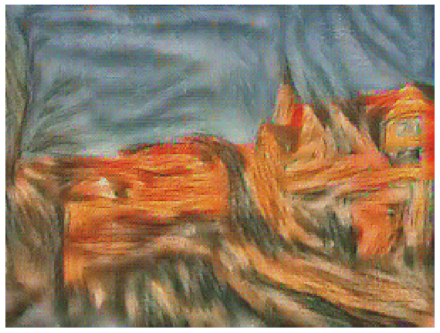
Scream + Tubingen
Include both original images and the transferred image

Slide 15
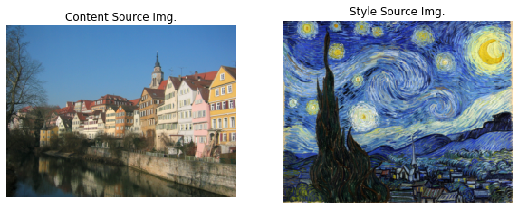
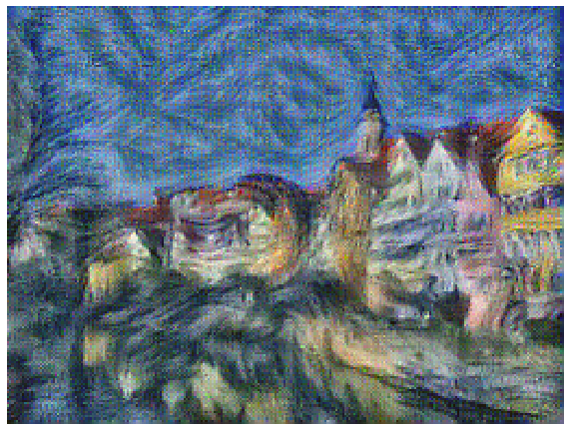
Starry Night + Tubingen
Include both original images and the transferred image

Slide 16
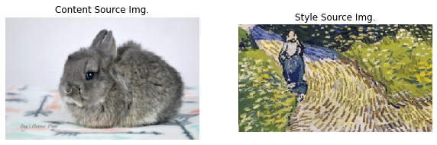
Style Transfer – Unleash Your Creativity
Include your two original images (content and style images)

Slide 17
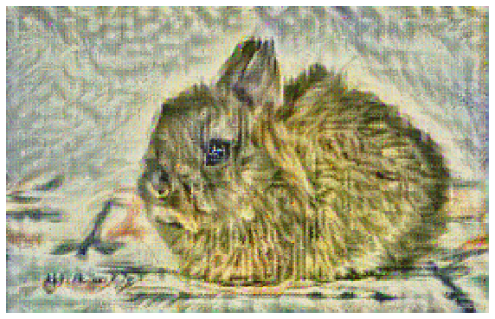
Style Transfer – Unleash Your Creativity
Include your final stylized image

Slide 18
3 Wrap-Up
Paper: Quan Zheng, Ziwei Wang, Jie Zhou, Jiwen Lu. “Shap-CAM: Visual Explanations for Convolutional Neural Networks based on Shapley Value”. 2022.
Summary:
This paper propose a new method to visualize neural network – Shap-CAM. While previous method, such as Grad-CAM, using gradients to determine the importance of pixels, Shap-CAM relies on Shapley value to estimate the marginal contribution of pixels to the model output. ShapCAM is able to achieve superior performance on visualization, recognition and localization tasks.

Slide 19
3 Wrap-Up (cont'd)
Shap-CAM obtains unique advantages over gradient-based approaches: it takes into account the relations between each pixels. The authors borrow a game-theory idea to measure the interactions among pixels.
One important takeaway from this study is the integration of game theory into deep learning studies. Shapley value is used to measure the marginal contribution of each player in a cooperative game. The author innovatively map that into a computer-vision problem, it not only offers new insights on how to incorporate pixel/member interactions into visualization, but also perfectly depicts the inter-disciplinary future of research.

